Slide 1


Slide 2


Slide 3


Slide 5
The Paid Engine of Growth
If either company wants to increase the revenue from each customer or drive down the cost of acquiring a new customer.
Growth rate depend on lifetime value(LTV) – cost per acquisition(CPA)

Slide 6
LTV (lifetime value)
CPA (cost per acquisition)

Slide 9
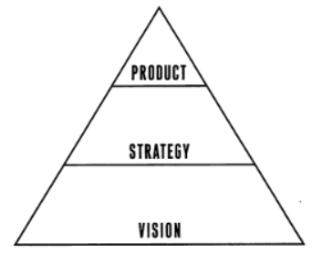
THE ROOT OF LEAN STARTUP

Slide 10
SETUP
ต้องมีเครื่องมือ และ วิธีการที่ดี
ต้องมีวิสัยทัศน์ที่ดี

Slide 12
Build-Measure-Learn
Leap-of-faith assumptions

Slide 13
Build-Measure-Learn
Leap-of-faith assumptions

Slide 14
Build-Measure-Learn
Leap-of-faith assumptions

Slide 15
Persevere
Pivot

Slide 16
Persevere
Pivot
Build-Measure-Learn
Leap-of-faith assumptions

Slide 17
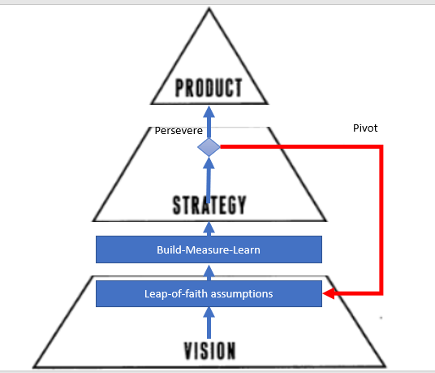

Slide 19
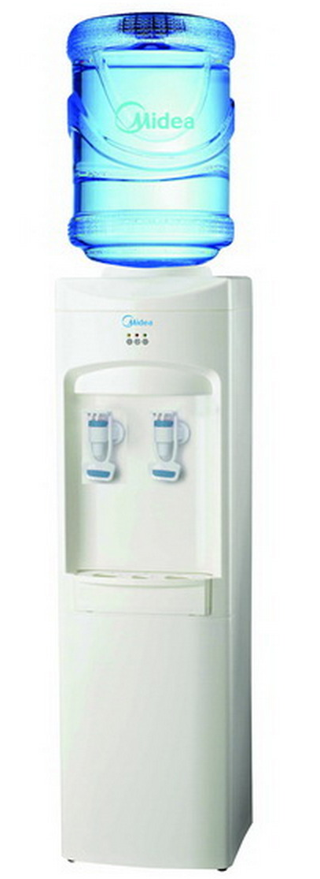
Leap-of-faith assumptions

Slide 20
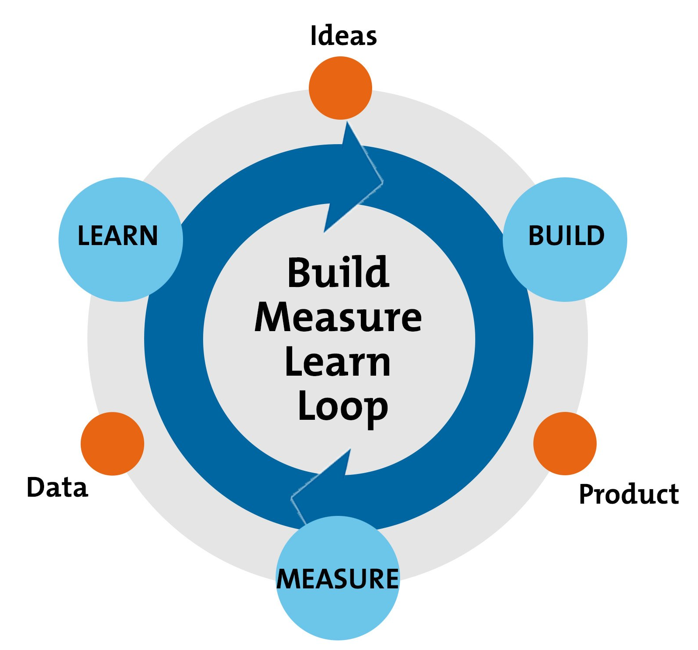
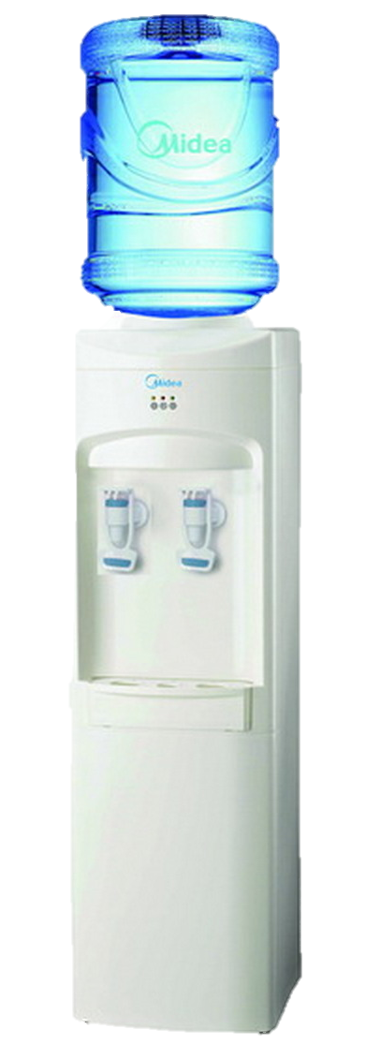
Leap-of-faith assumptions

